Slide 1

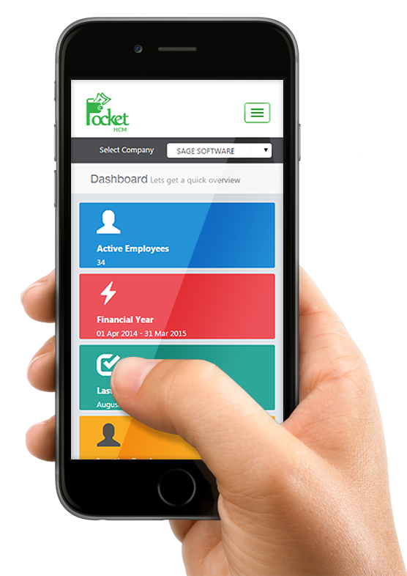
How to Develop first Laravel WISS – Web Interactive Self-Service Aisin Asia Pacific
WISS
20 Feb 2022
Traitet Th. Line @traitet

Slide 2
1. Create Project
No | Code | Code
1 | Create Laravel Project Open vscode and open folder wissdemo01 Required Install Composer 2.2.6 (Laravel) – download from internet Install Vscode and package related Laravel and php Install Last Xampp 8.1.2 (PHP 8) Set path in variable environment to open php, composer from any path in windows | composer create-project --prefer-dist laravel/laravel wissdemo01
2 | Create repo on github named “wissdemo01” Run command | commit for local git Run command | push to git cloud Required Register github Install git on windows | echo "# wissdemo01" >> README.md git init git add README.md git add . git commit -m "first commit" git branch -M main git remote add origin https:/github.com/traitet/wissdemo01.git git push -u origin main
3 | php artisan serve | php artisan serve
4 | Open URL e.g. http://10.100.1.94:8080

Slide 3
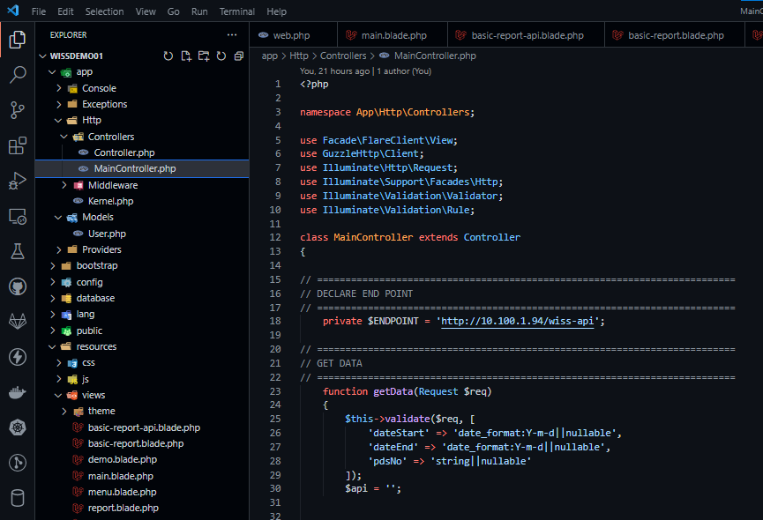
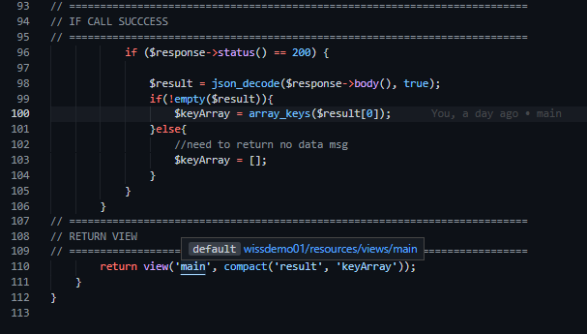
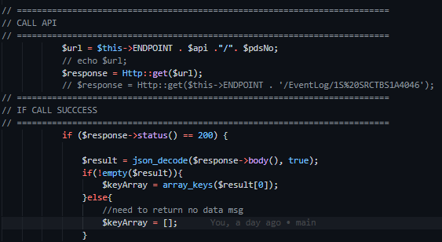
Code ตัวอย่าง | Main Controller
Import http
Return View
Validate data
Call API
If success

Slide 4
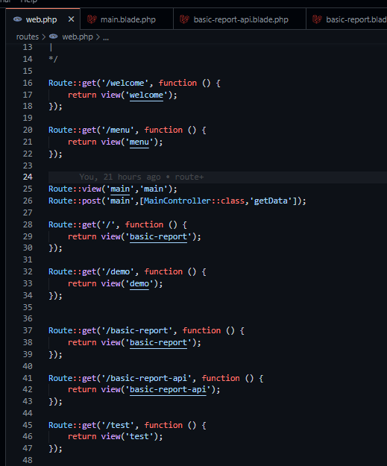
Routes | web.php
Get
1) Call [root path]/welcome e.g. 10.100.1.94/welcome
2) Show view webcome
Post → Call controller
Call getData
Return view (View = main.blade.php)

Slide 5
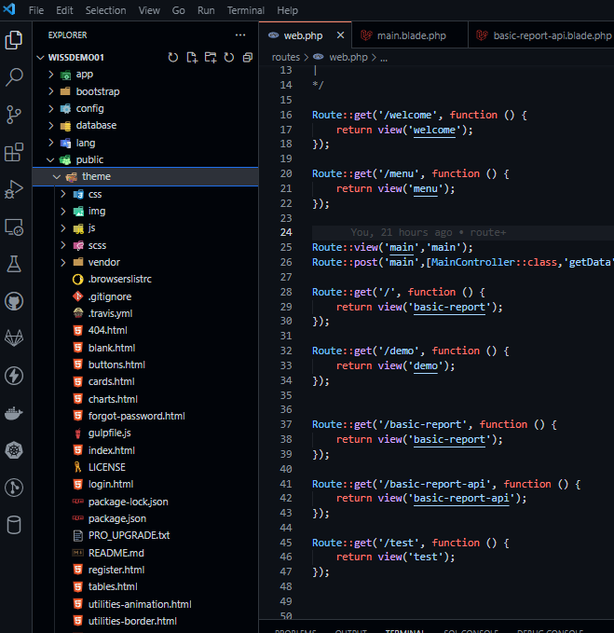
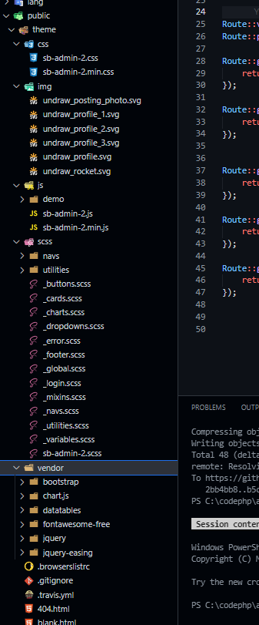
Theme SB
Can copy all for sample code

Slide 6
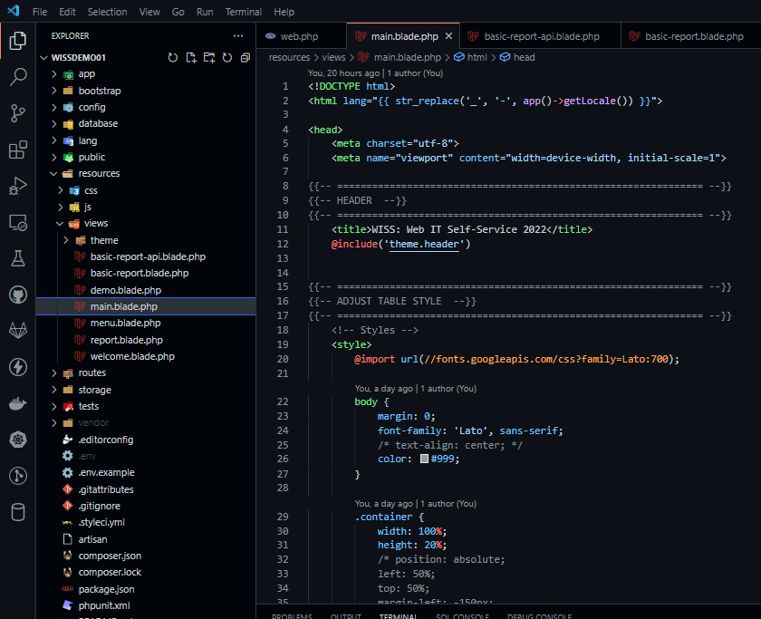
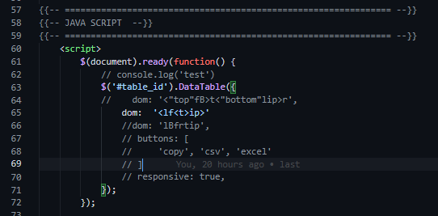
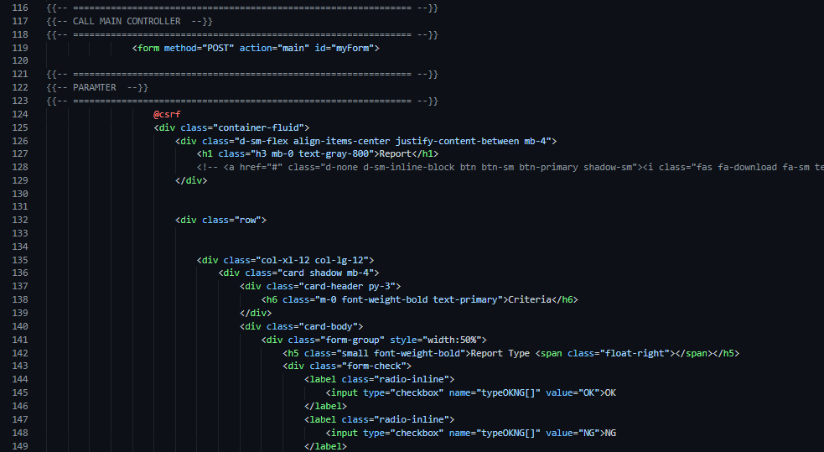
Sample View | Main.blade.php
Adjust data table
Link to main controller
Show data table

Slide 7
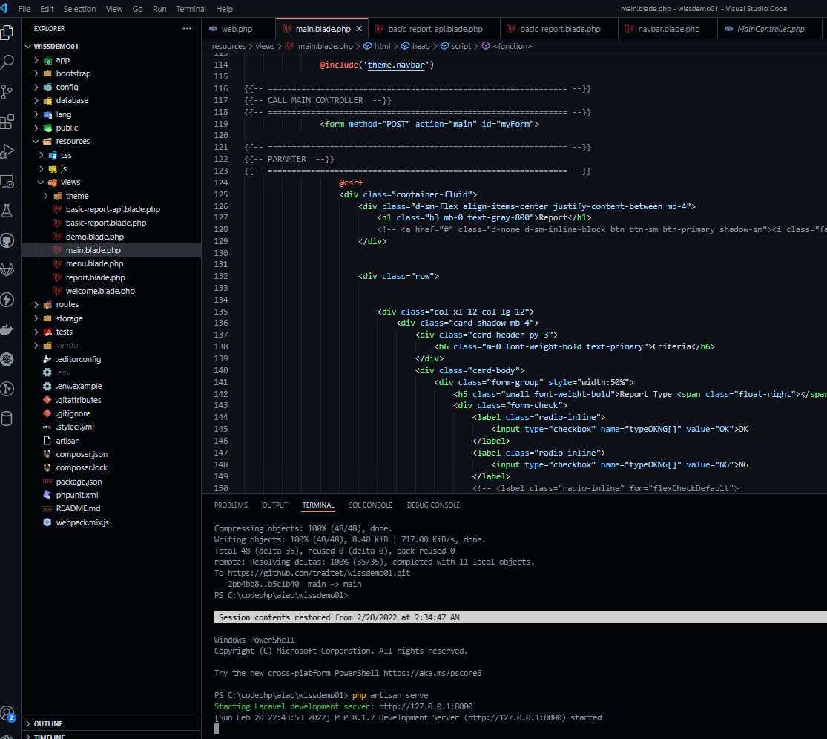
Run service | php artisan serve

Slide 8
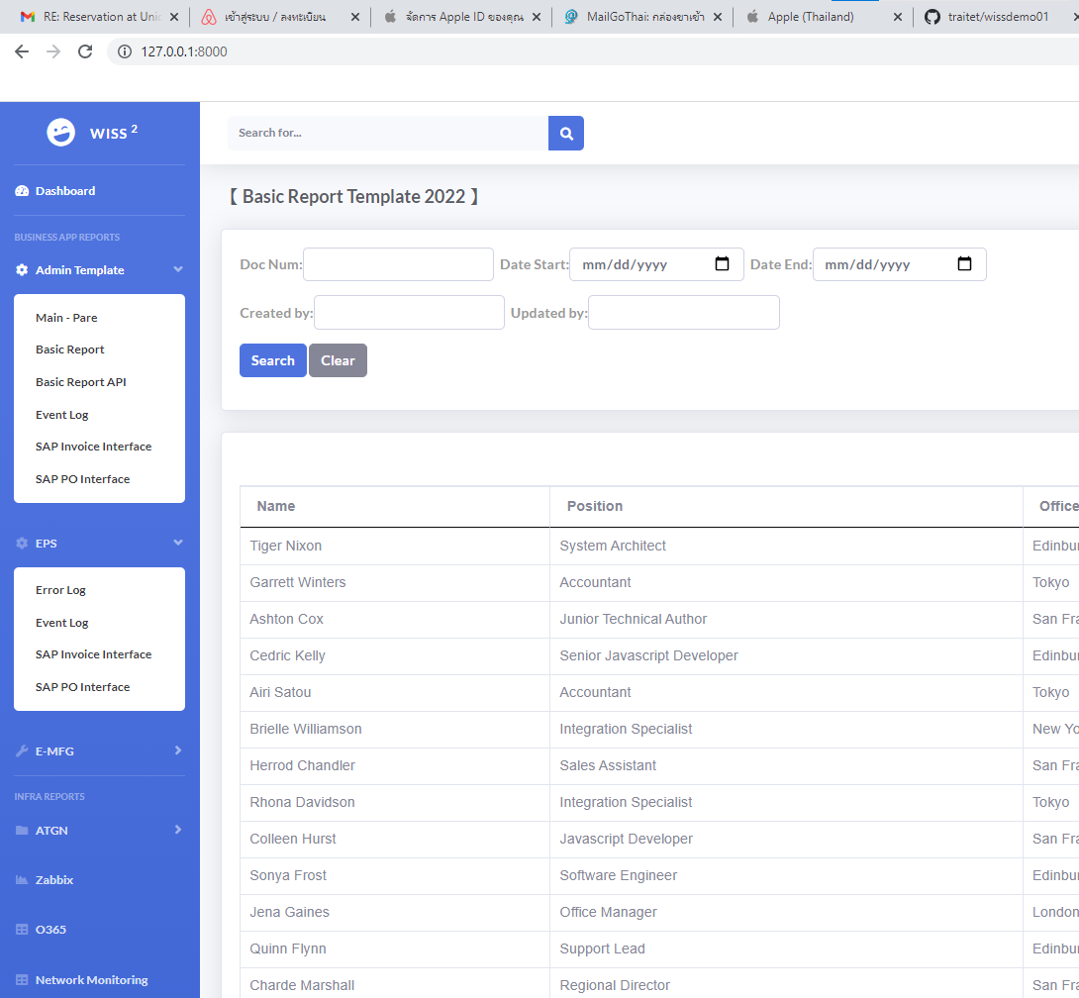
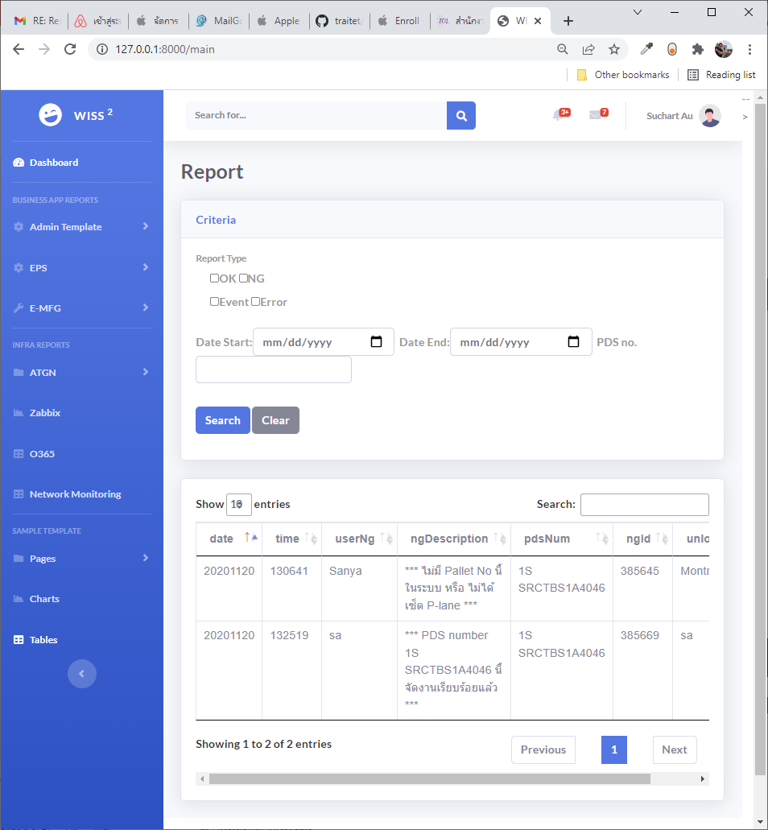
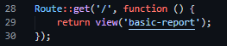
Sample web
Basic Report
Pare’s report
Basic report template
View = /basic-report
Route : return view(‘basic-report’)

Slide 9
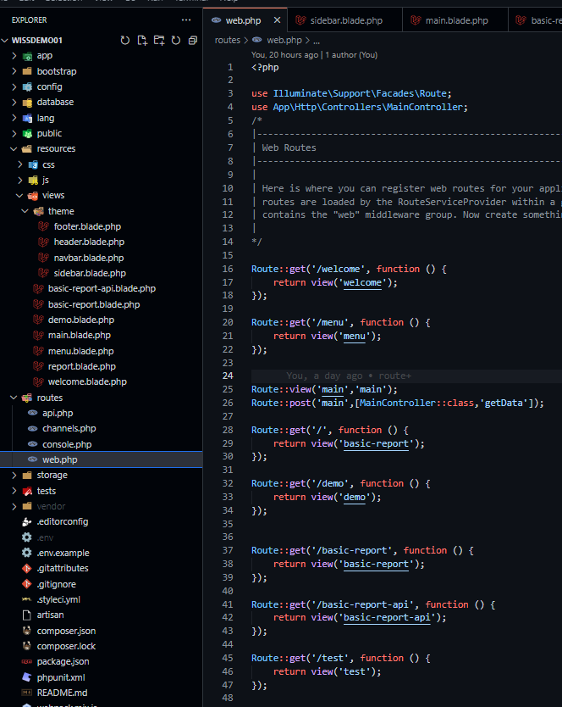
Sample web
Don’t forget to add controller
Main | get and post
Basic Report
Pare’s report
Basic Report
Basic report template
View = /basic-report
Route : return view(‘main’)
Basic report template
View = /basic-report
Route : return view(‘basic-report’)
Route/web.php

Slide 10
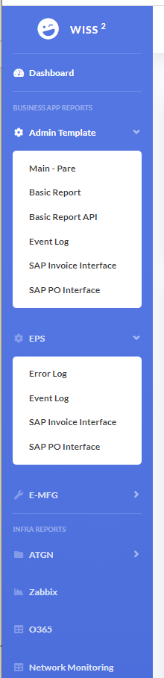
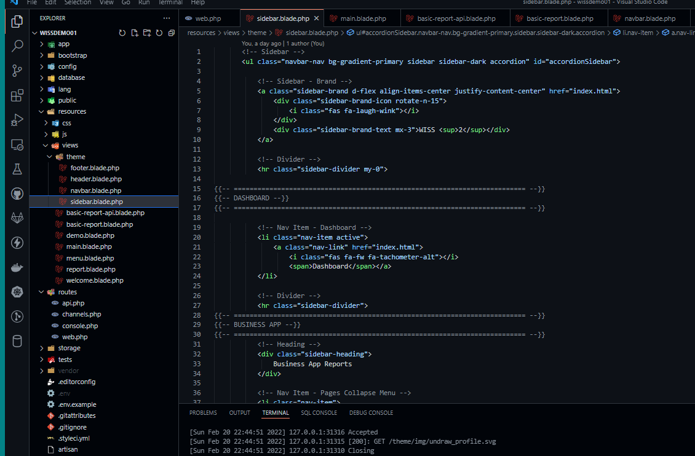
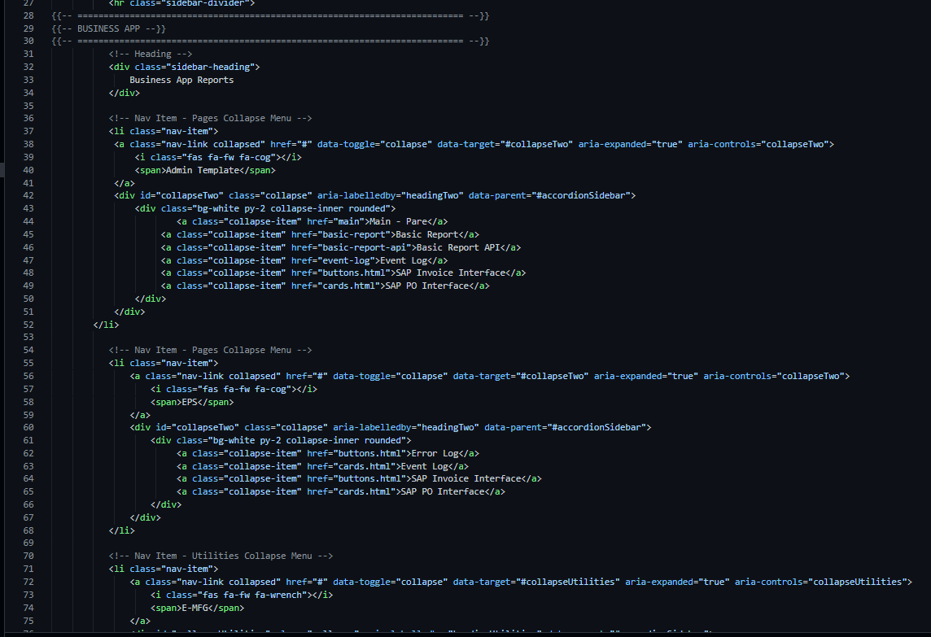
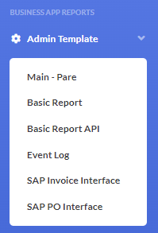
Adjust Navigation Bar

Slide 11
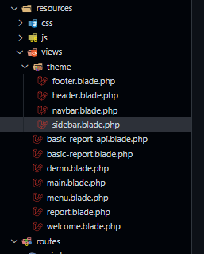
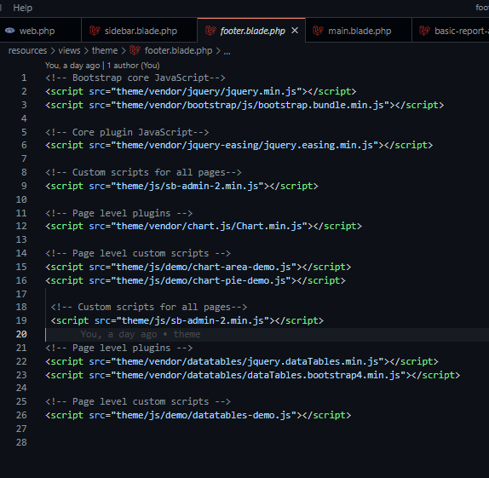
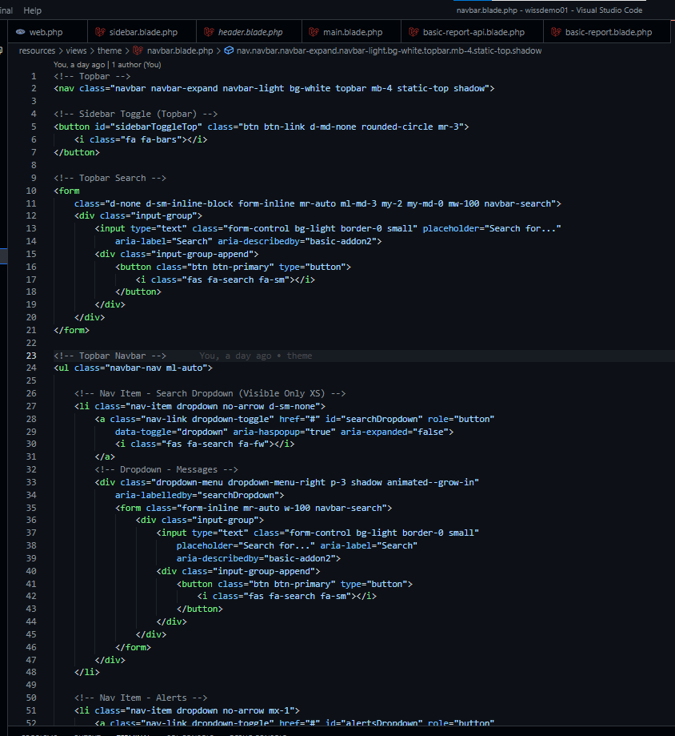
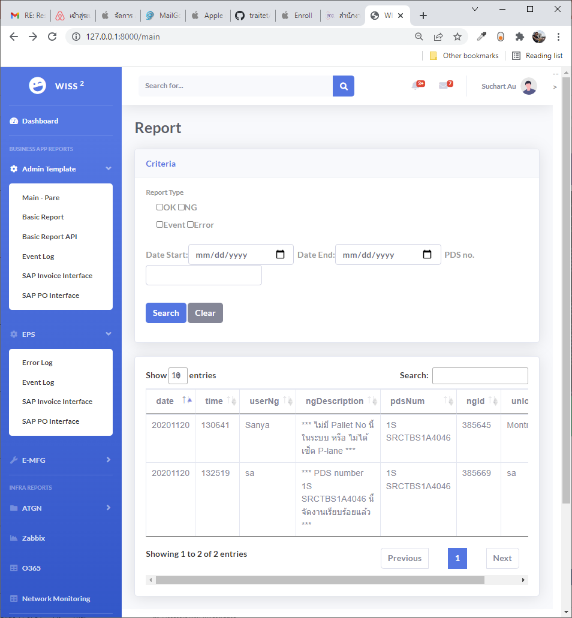
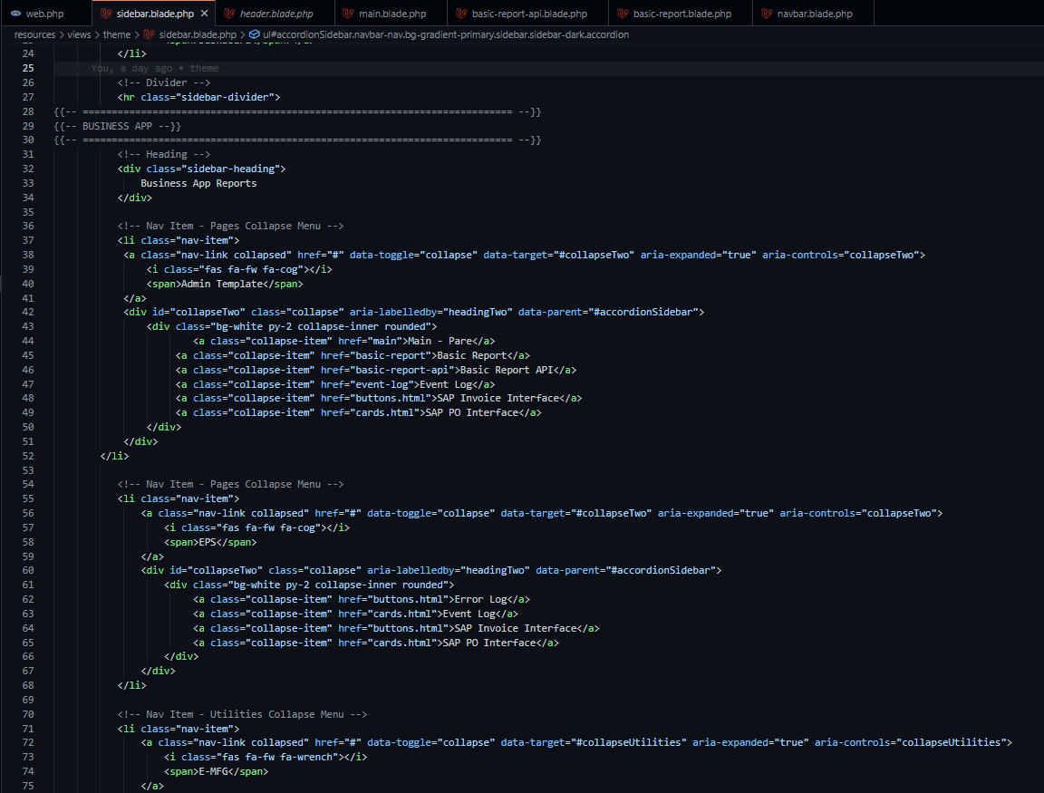
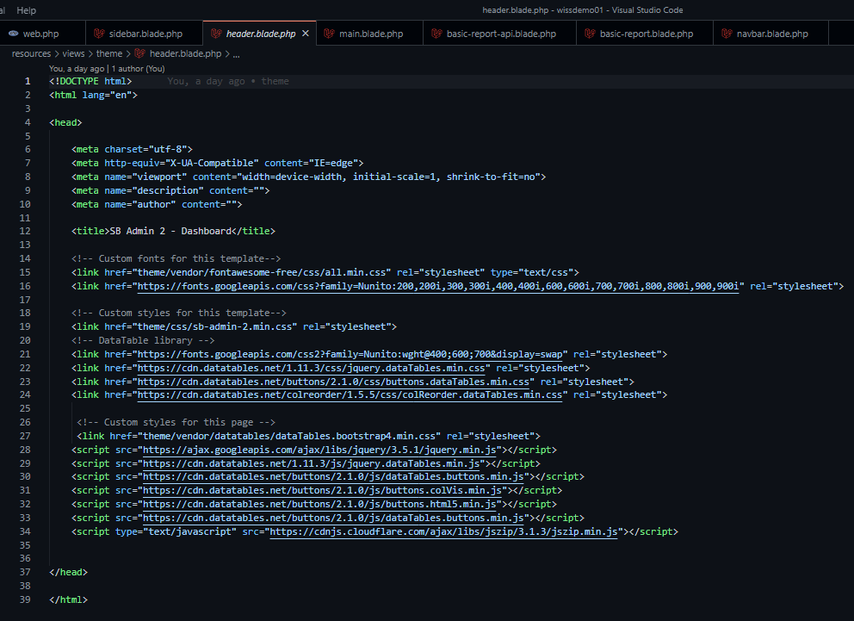
Header, Footer, Nav Bar, Slide Bar
Header
Slide Bar, Nav Bar
Data Table
Fotter
Footer
Slide Bar & Nav Bar
Header

Slide 12
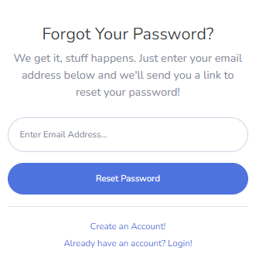
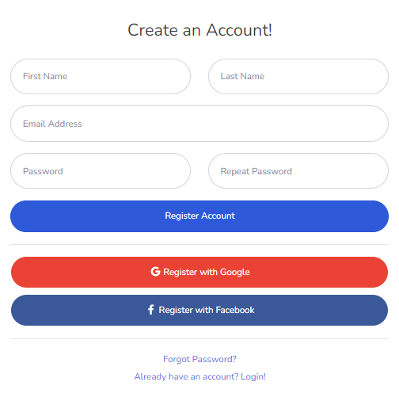
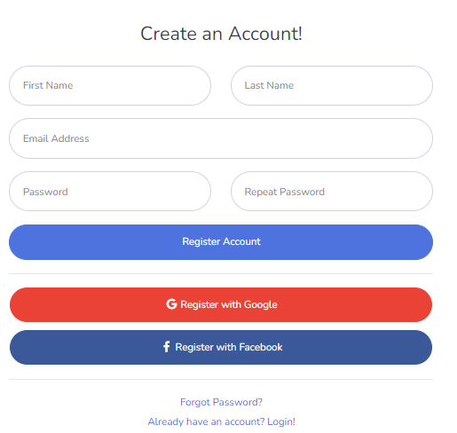
Login, register and forget password

Slide 13
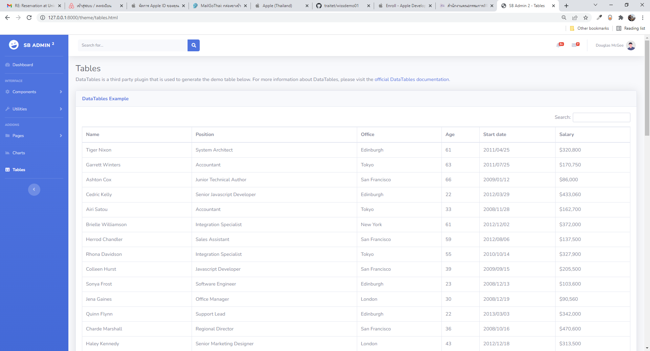
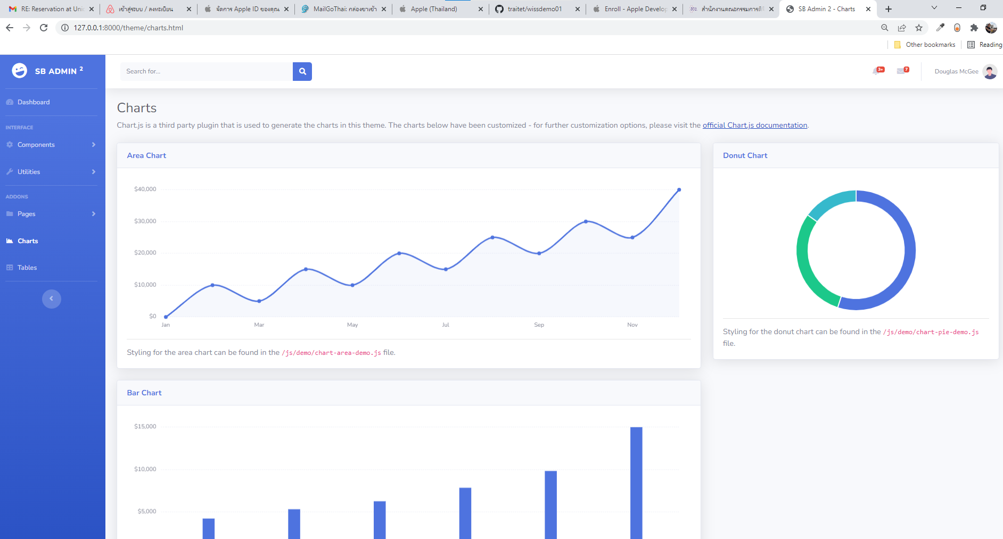
Chart and Table
Table (Data Table)
Chart

Slide 14
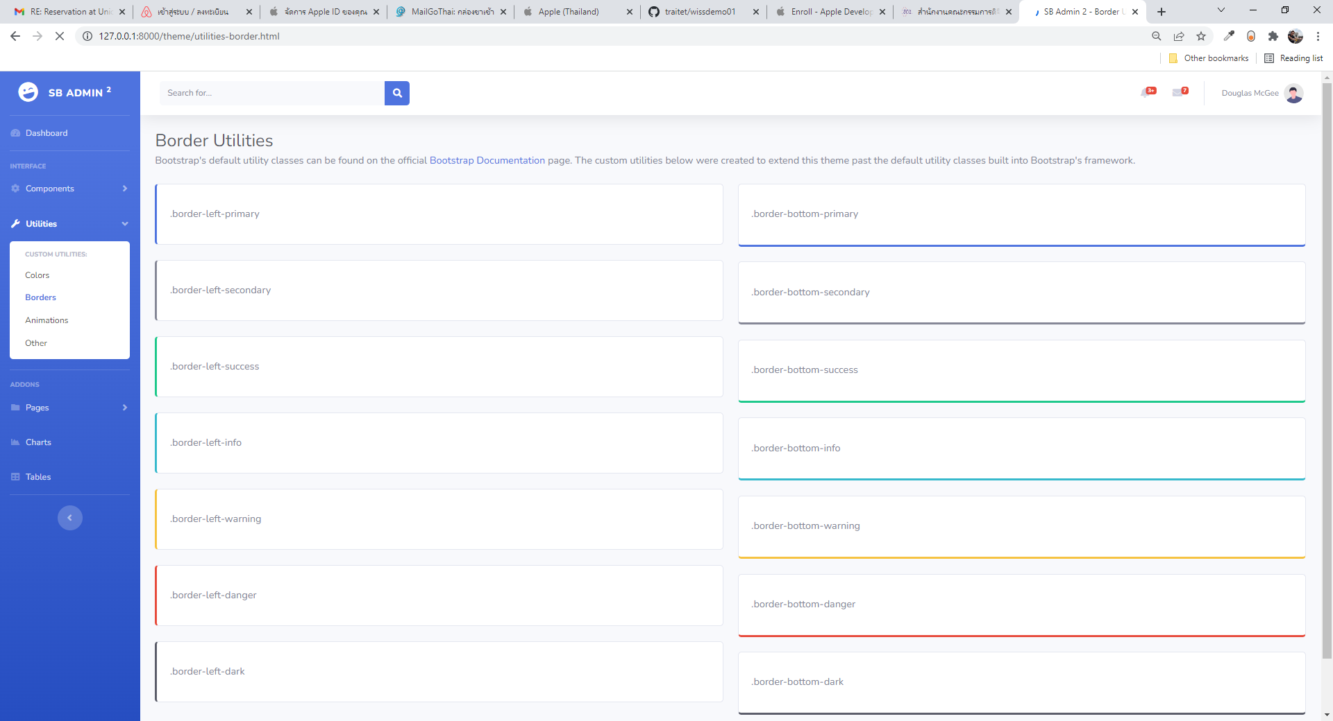
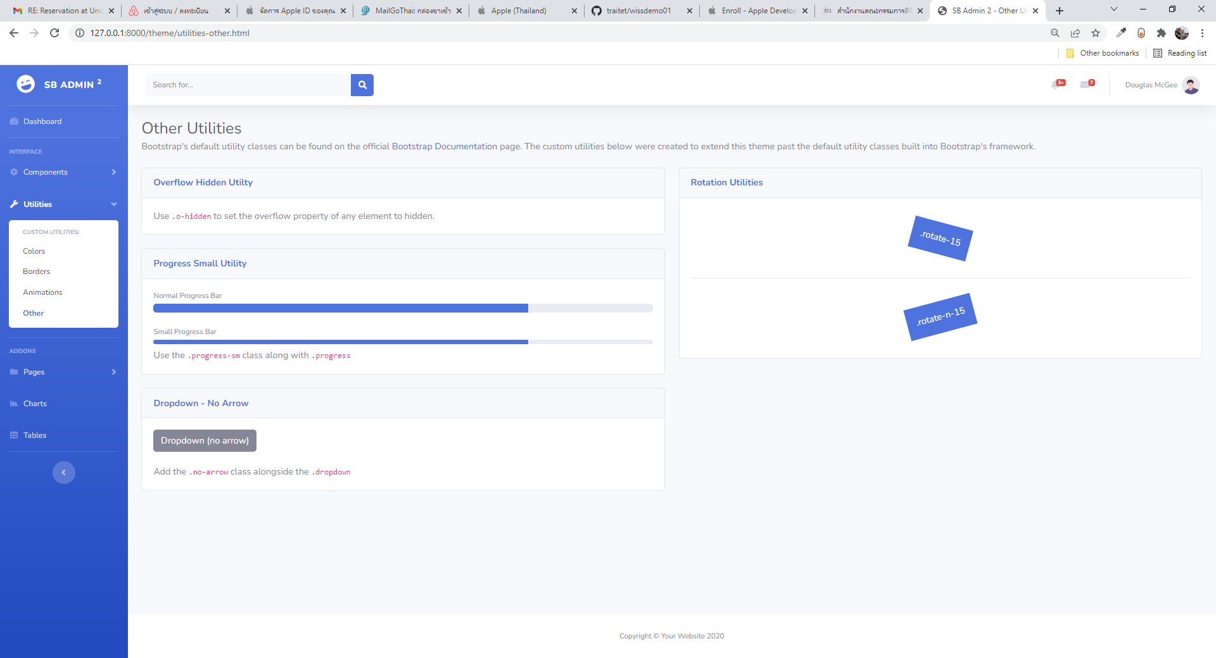
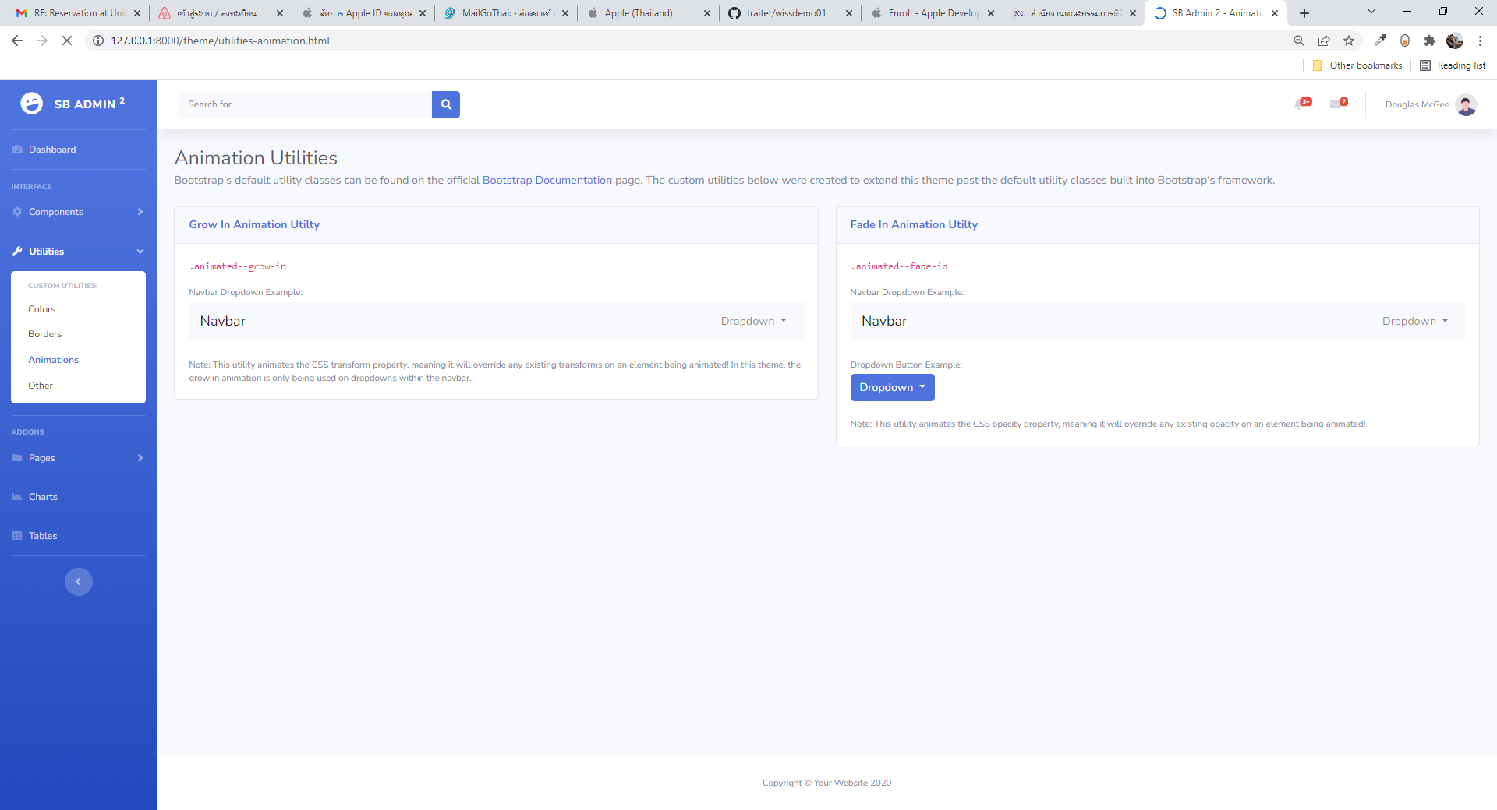
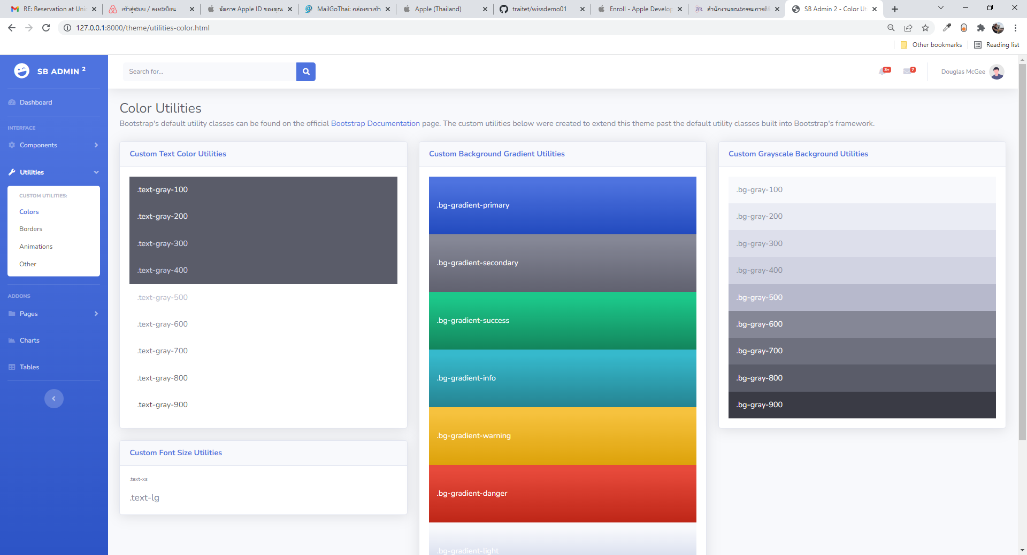
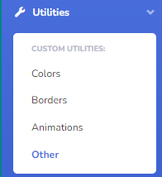
Sample
Border
Other
Animate
Color

Slide 15
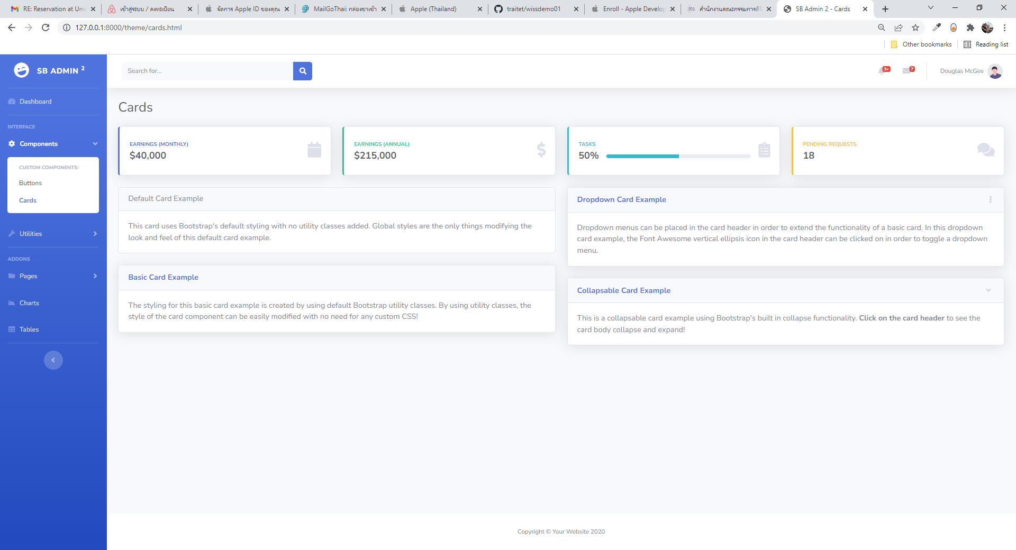
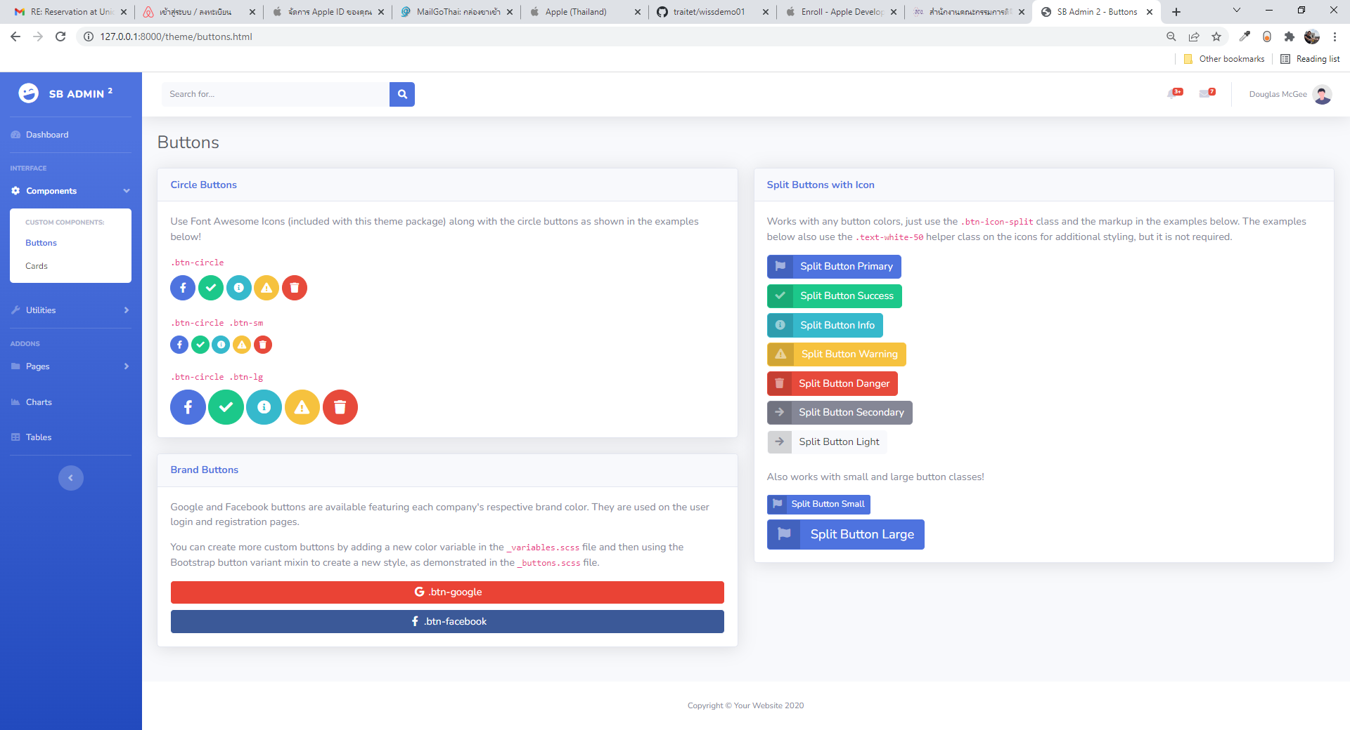
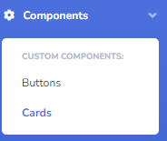
Sample Component
Button
Card

Slide 16
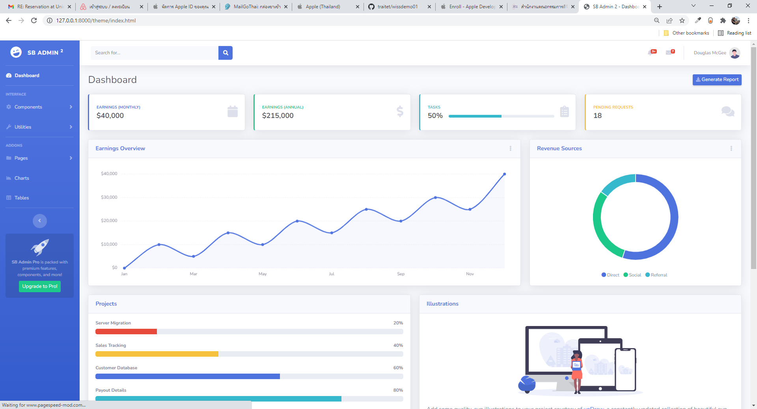
Dashboard

Slide 17
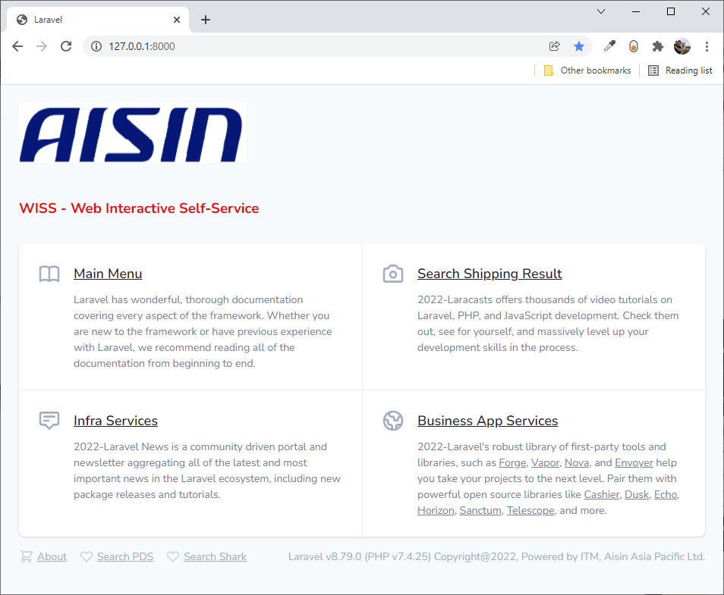
MVC
Resources/views/flights/show.blade.php
Resources/views/flights/index.blade.php
Resources/views/flights/edit.blade.php
Resources/views/ flights/new.blade.php
App/Models/Flight.php
1. Request URL
Model
View
Database
5. Render view in browser
Model: Data storage, integrity, consistency, queries
Controller: Receive, Interpret & validate input, create & update view, modify model
View: presentation, asset & code (HTML)
4. Controller get Result View
Return View
Controller
Return View
Routing
3. Interact with Data Model
2. Re-route to
correct Laravel Controller
App/Controllers/FlightController.php
routes/web.php
View (get) index, show, edit, new

Slide 18
How to clone git

Slide 19
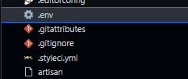
1. How to clone git
No | Step | Code
1 | Clone git Pull git Required To share git with other: Settings, Collaboration, Add People “git ID or mail” Accept by people added | git clone https:/github.com/traitet/wissdemo01.git git pull
2 | Download package | npm install composer install
3 | Change .env.example to .env
3 | php artisan serve | php artisan serve
4 | Open URL e.g. http://10.100.1.94:8080

Slide 20
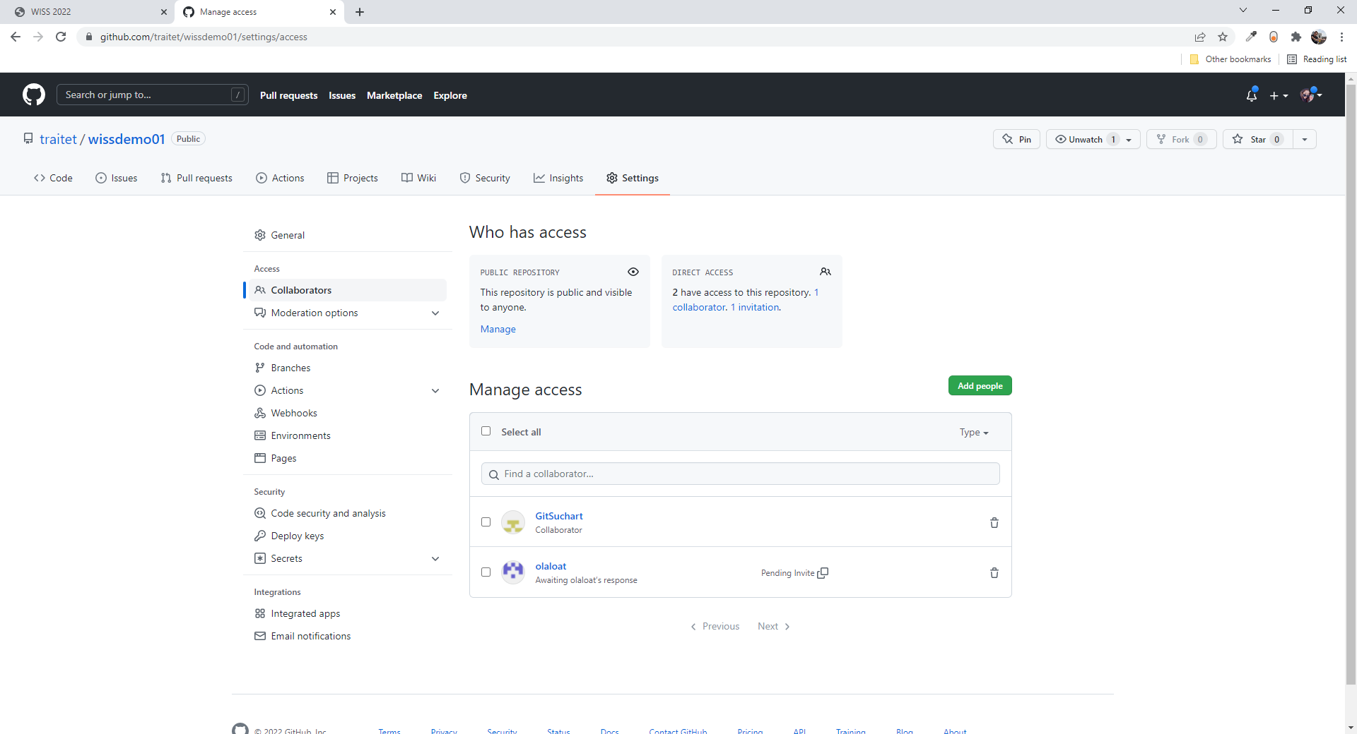
Git Hub : add Collaborators

Slide 21
Develop Web API

Slide 22
Web api on Laravel ตัวอย่าง web api ที่ deploy
http://10.100.1.94:8080/wissdemo01/public/api/interface_sap_po http://10.100.1.94:8080/wissdemo01/public/api/interface_sap_po/PO19000483
http://10.100.1.94:8080/wissdemo01/public/api/interface_sap_rec
http://10.100.1.94:8080/wissdemo01/public/api/interface_sap_rec/PO19002270
http://10.100.1.94:8080/wissdemo01/public/api/interface_sap_inv
http://10.100.1.94:8080/wissdemo01/public/api/interface_sap_inv/PO19000483

Slide 23
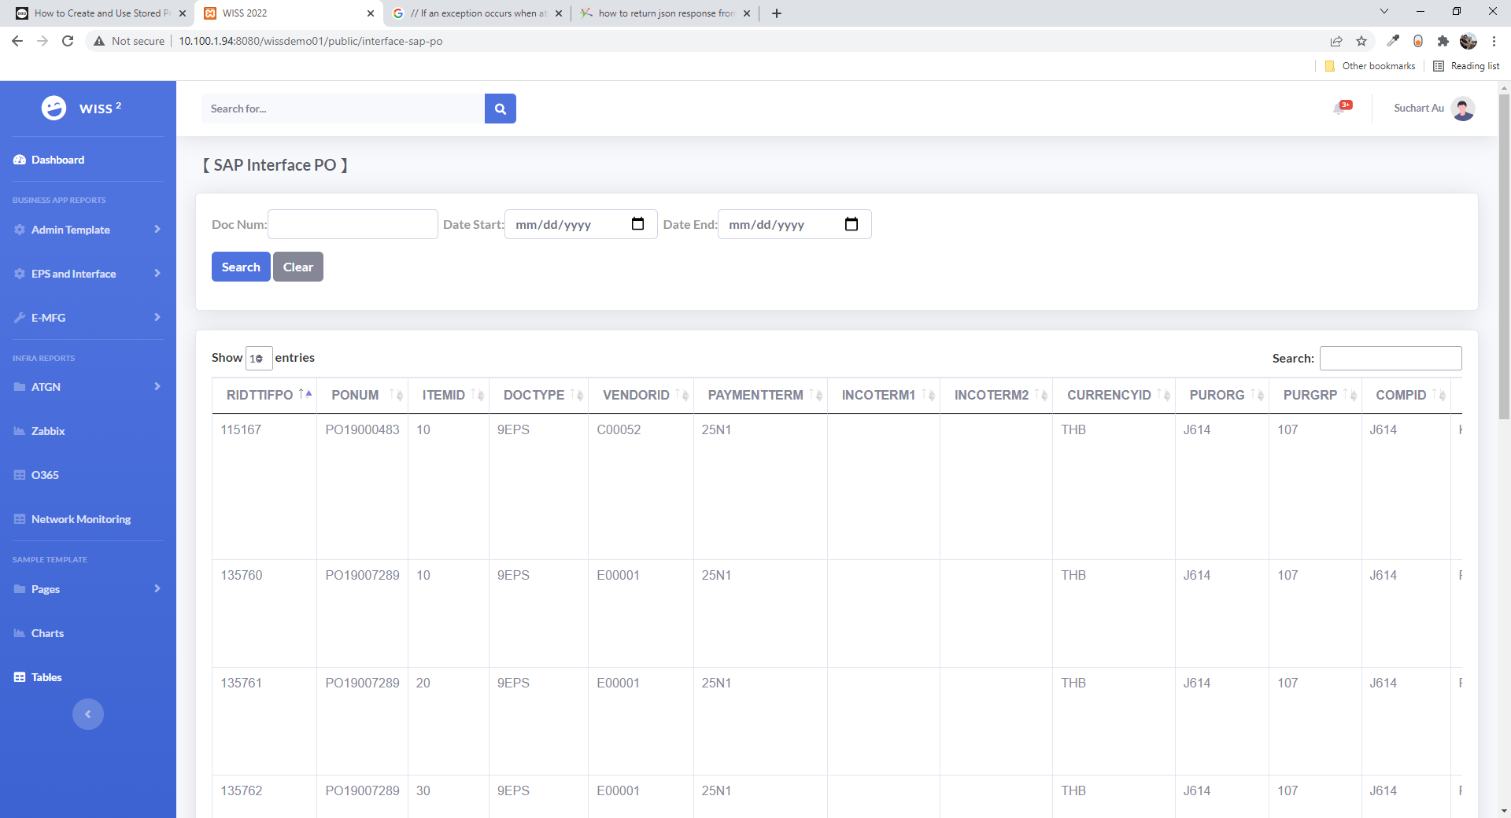
http://10.100.1.94:8080/wissdemo01/public/interface-sap-po
view
controller
route
Consumed web api by Front-end

Slide 24
Steps ในการเขียน web api Laravel call sql server store procedure
Download driver file | https:/medium.com/@anurat/%E0%B9%80%E0%B8%8A%E0%B8%B7%E0%B9%88%E0%B8%AD%E0%B8%A1%E0%B8%95%E0%B9%88%E0%B8%AD-sql-server-%E0%B8%81%E0%B8%B1%E0%B8%9A-laravel-%E0%B8%9A%E0%B8%99-windows-d724aec1ea02
Copy file to php/ext | C:\xampp\php\ext\php_pdo_sqlsrv_81_ts_x64.dll
Add link in Php.ini | extension=php_pdo_sqlsrv_81_ts_x64
Open xamp, phpinfo(), find sqlsrv | http://localhost:8080/dashboard/phpinfo.php
Config .env file | DB_CONNECTION=sqlsrv DB_HOST=10.100.1.47 DB_PORT=49382 DB_DATABASE=SIAM_EPSINFDB DB_USERNAME=wiss01 DB_PASSWORD=wiss01@app
Create controller | php artisan make:controller WissApiController –resource
Add controller code | public function index() { /curl http://10.100.1.94:8080/wissdemo01/public/api/wiss-apis $result = DB::select('select * from TMIFIO'); return json_encode($result); } public function show($id) { if ($id == 'a') {$result = DB::select('select TOP 10 * from TMIFIO');} /curl http://10.100.1.94:8080/wissdemo01/public/api/wiss-apis/a if ($id == 'b') {$result = DB::select('select TOP 10 * from TMIFMAT');} /curl http://10.100.1.94:8080/wissdemo01/public/api/wiss-apis/b if ($id == 'c') {$result = DB::select('select TOP 10 * from TMIFVEN');} /curl http://10.100.1.94:8080/wissdemo01/public/api/wiss-apis/c return json_encode($result); }
Test by curl | Php artisan serve curl http://10.100.1.94:8080/wissdemo01/public/api/wiss-apis/c

Slide 25
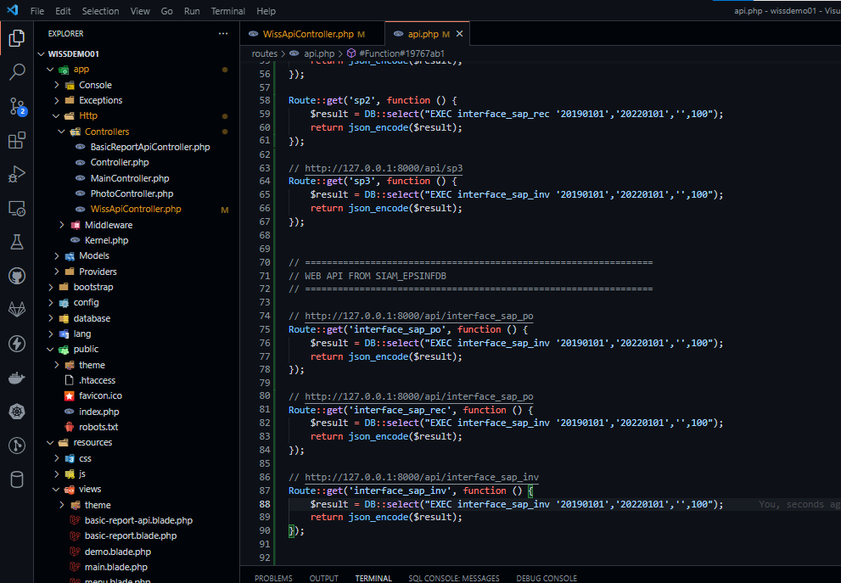
ตัวอย่าง code web api ที่เขียนใน controller
/ ================================================================
/ WEB API FROM SIAM_EPSINFDB
/ ================================================================
/ http://10.100.1.94:8080/wissdemo01/public/api/interface_sap_po
Route::get('interface_sap_po', function () {
$result = DB::select("EXEC interface_sap_inv '20190101','20220101','',100");
return json_encode($result);
});
/ http://10.100.1.94:8080/wissdemo01/public/api/interface_sap_po
Route::get('interface_sap_rec', function () {
$result = DB::select("EXEC interface_sap_inv '20190101','20220101','',100");
return json_encode($result);
});
/ http://10.100.1.94:8080/wissdemo01/public/api/interface_sap_inv
Route::get('interface_sap_inv', function () {
$result = DB::select("EXEC interface_sap_inv '20190101','20220101','',100");
return json_encode($result);
});

Slide 26
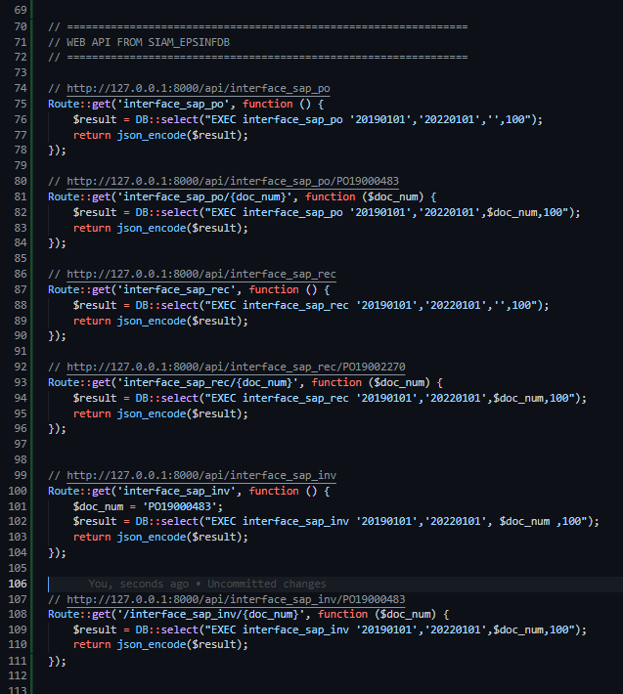
ตัวอย่าง code web api ที่เขียนใน controller ที่เขียนใน route: api.php
เขียน code หน้าเดียว Call ทุก store ที่อยู่ใน database เดียวกัน (sql server)

Slide 27
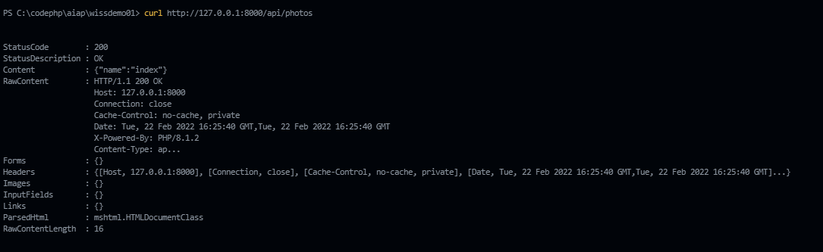
วิธีการนำ Git มาใช้งาน และเขียน web api บน Laravel
No | Step | Code
.1 | Run command (Create web api) Add api route | php artisan make:controller PhotoController –resource Route::resource('photos', 'App\Http\Controllers\PhotoController');
2 | Copy code | https:/www.poolsawat.com/laravel-%E0%B8%AA%E0%B8%A3%E0%B9%89%E0%B8%B2%E0%B8%87-restful-api-%E0%B8%87%E0%B9%88%E0%B8%B2%E0%B8%A2-%E0%B9%86-%E0%B8%94%E0%B9%89%E0%B8%A7%E0%B8%A2-resource-routes-controller-ep5/
3 | Run test on terminal | php artisan serve curl http://10.100.1.94:8080/wissdemo01/public/api/photos curl http://10.100.1.94:8080/wissdemo01/public/api/photos/create curl -X POST -H "Content-Type: application/json" -d "{\"name\":\"poolsawat.com\"}" http://10.100.1.94:8080/wissdemo01/public/api/photos curl -X DELETE http://10.100.1.94:8080/wissdemo01/public/api/photos/9999

Slide 28
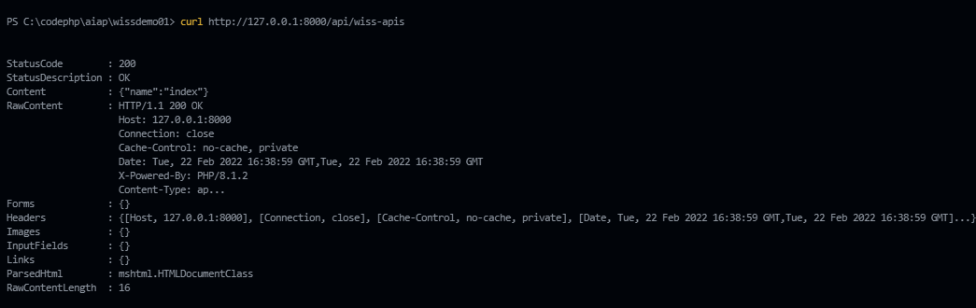
1. How to clone git
No | Step | Code
.1 | Run command (Create web api) Add api route | php artisan make:controller WissApiController –resource Route::resource('wiss-apis', 'App\Http\Controllers\WissApiController');
2 | Copy code | return response()->json(['name' => 'index']);
3 | Run test on terminal | php artisan serve curl http://10.100.1.94:8080/wissdemo01/public/api/wiss-apis curl http://10.100.1.94:8080/wissdemo01/public/api/wiss-apis/eventlog

Slide 29
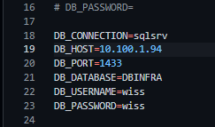
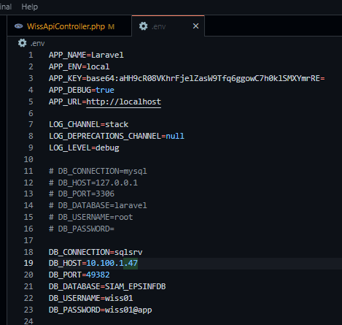
.env
ไฟล์ .env เพื่อ config database ที่ใช้งาน
Sql server

Slide 30
.env file | DB_CONNECTION=sqlsrv DB_HOST=10.100.1.47 DB_PORT=49382 DB_DATABASE=SIAM_EPSINFDB DB_USERNAME=wiss01 DB_PASSWORD=wiss01@app
WissApiController.php | $result = DB::select('select * from TMIFIO'); return json_encode($result);
Test command | Php artisan serve curl http://10.100.1.94:8080/wissdemo01/public/api/wiss-apis
การ connect กับ sql server โดยใช้ Laravel และ เขียน web api

Slide 31
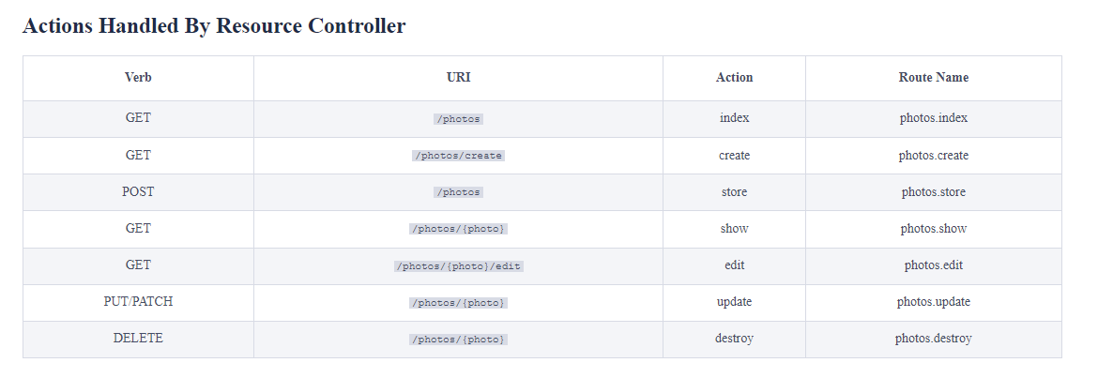
Actions Handled by resource controller
Controller พื้นฐานของ Laravel (MVC)

Slide 32
Connect SQL server
https:/medium.com/@anurat/%E0%B9%80%E0%B8%8A%E0%B8%B7%E0%B9%88%E0%B8%AD%E0%B8%A1%E0%B8%95%E0%B9%88%E0%B8%AD-sql-server-%E0%B8%81%E0%B8%B1%E0%B8%9A-laravel-%E0%B8%9A%E0%B8%99-windows-d724aec1ea02
Download file e.g. php_sqlsrv_81_ts_x64.dll
Copy to php/ext folder
Add link in php.ini e.g. extension=php_sqlsrv_81_ts_x64 (สุดท้ายใช้อีกตัว)
Php artisan serve
ขั้นตอน connect กับ sql

Slide 33

รูปการณ์ config php.ini บน web server, xampp

Slide 34
How to develop Store Procedure
24 Feb 2022

Slide 35
How to develop Store Procedure
No
1. Use Excel online for design | https://aisingroupap01.sharepoint.com/:x:/s/ITM/EdGCycUJhoVJvGWKfUm5Y-EBog7ZRNksxqD2dvF-bVD6Ow
2. Dev on VsCode & Use GitHub for sharing code | https://github.com/traitet/wisssql01.git
3. Create/alter store procedure
4. Test store procedure
5. Update Excel Online File e.g. how to call, DB

Slide 36




Capture image
Git Hub
VSCode
SQL Server
Excel Online (Design)

Slide 37
Sample Code
USE [SIAM_EPSINFDB]
GO
/****** Object: StoredProcedure [dbo].[interface_sap_po] Script Date: 23/02/2022 3:34:58 PM ******/
SET ANSI_NULLS ON
GO
SET QUOTED_IDENTIFIER ON
GO
-- =========================================================
-- interface_sap_po
-- Created by : Nuttawut
-- Created date : 23-02-2022
-- Updated date : 23-02-2022
-- =========================================================
ALTER PROCEDURE [dbo].[interface_sap_po]
@start_date AS VARCHAR(8),
@end_date AS VARCHAR(8),
@doc_num AS VARCHAR(8),
@record_count AS INT
AS
BEGIN
-- DECLARE @start_dateAS VARCHAR(8) = '20190524'
-- DECLARE @end_date AS VARCHAR(8) = '20210524'
-- DECLARE @doc_num AS VARCHAR(100) = ''
-- DECLARE @record_count AS INT = 100
SELECT
top (@record_count )
RIDTTIFPO, PONUM, ITEMID, DOCTYPE, VENDORID, PAYMENTTERM, INCOTERM1, INCOTERM2, CURRENCYID,
PURORG, PURGRP, COMPID, ISINVESTMENT, MATID, TXTCOMMENT, QUANTITY, UNIT, REQUIREDDATE, UNITPRICE, MATGRP,
PLANT, VATID, DEPTID, GLACCOUNT, INVESTMENTID, PRODUCTID, MACHINEID, PRODUCTIONLINEID, REQUIREDBY, PODATE,
CREATEDDATE, IFSTATUS, CARRYSTATUS, IFMESSAGE, OPTFIELD1, OPTFIELD2, OPTFIELD3, OPTFIELD4, OPTFIELD5, OPTFIELD6, OPTFIELD7
FROM TTIFPO
WHERE
IFSTATUS = 'E' and
PODATE >= @start_date and
PODATE <= @end_date and
PONUM LIKE '%' + @doc_num + '%'
ORDER BY RIDTTIFPO, PONUM
END
-- EXEC interface_sap_po '20190101', '20220101','',100
Default Basic Parameter

